Slide 1
Command Area Delineation Methods
Notes:
This template is to be used for a WIDE screen like LED TVs or newer projection screens.
If preparing a presentation for a STANDARD screen or older projection screen then please use the 4x3 format presentation template instead.
All templates are available on the IWMI INTRAnet at https://intranet.iwmi.org

Slide 2
Command Area
The command area of a WWTP is the region where treated wastewater is distributed for reuse.
It depends on factors like plant capacity, distribution network, and local water demand.
The water reuse area includes agricultural lands, landscaping zones, and industrial users.
These areas help reduce freshwater consumption and promote sustainable water management.

Slide 3
Command Area Delineation Method
Start with DEM and WWTP location as inputs.
Use the D8 flow direction method to trace the downstream flow path from the WWTP.
In Option 1, the flow path has a fixed length of 5 km. In Option 2, the flow path length varies based on the discharge rate, infiltration rate, and evaporation rate.

Slide 4
Command Area Delineation Method Option 1
Elevation of WWTP Location
Trace Stream path in D8 method
Input Dem
Tracing within 5km Buffer around WWTP
500m Buffer around Flow path
Remove areas higher than wwtp elevation +50m

Slide 5
Command Area Delineation Method Option 2
Input Dem
Elevation of WWTP Location
Trace Stream path (D8 method)
Discharge of WWTP (Q)
Flow Losses (Infiltration, evaporation, flow attenuation - routing)
Flow Discharge in New Grid
Remove areas higher than wwtp elevation +50m
500m Buffer around Flow path
Flow Path Stopping Criteria
Q < 2 Cumecs

Slide 6
Difference Between Option 1 & 2
Feature | Option 1 | Option 2
Flow Path | Fixed 5 km along the river from WWTP | Based on how far water flows before discharge becomes zero
Buffer | 500 m buffer around the 5 km path | Same 500 m buffer around the real flow path
Elevation Filter | Remove areas more than 50 m above WWTP | Same
Discharge Consideration | Not considered | Discharge reduced due to evaporation and infiltration
Flow Calculation Method | Simple assumption | Muskingum Routing method (real water movement)
Accuracy | Basic, may overestimate command area | More realistic – considers actual water availability

Slide 7
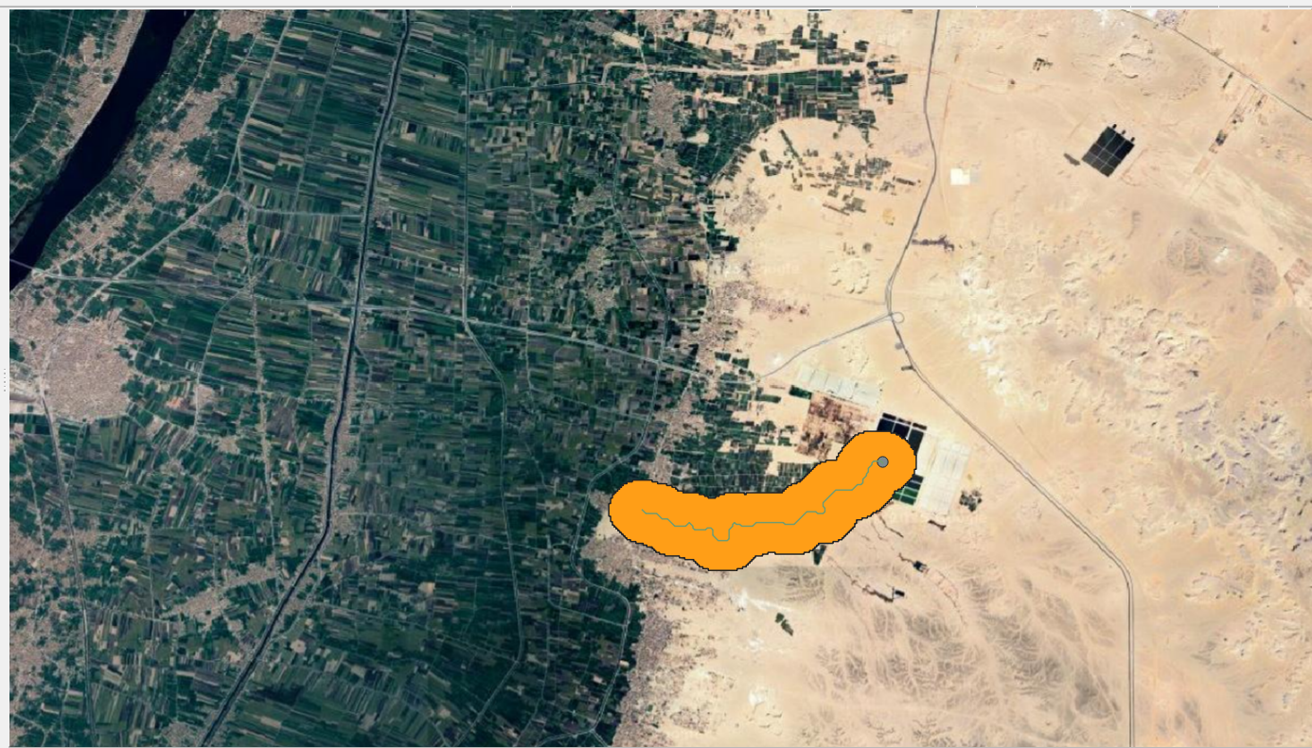
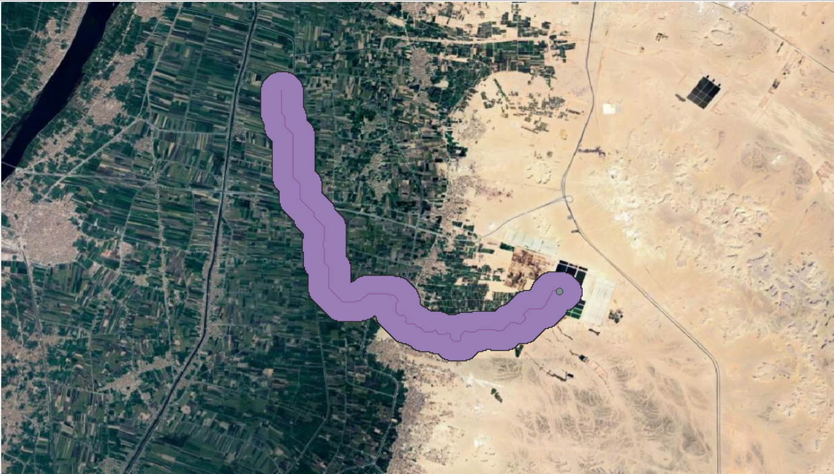
Examples in Egypt
Quos WWTP (15,000 m³/day)
Option 1
Option 2
5km
13km

Slide 8
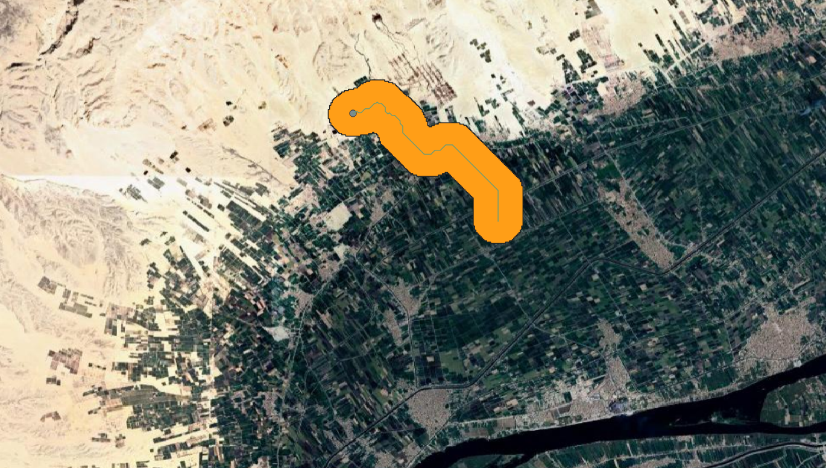
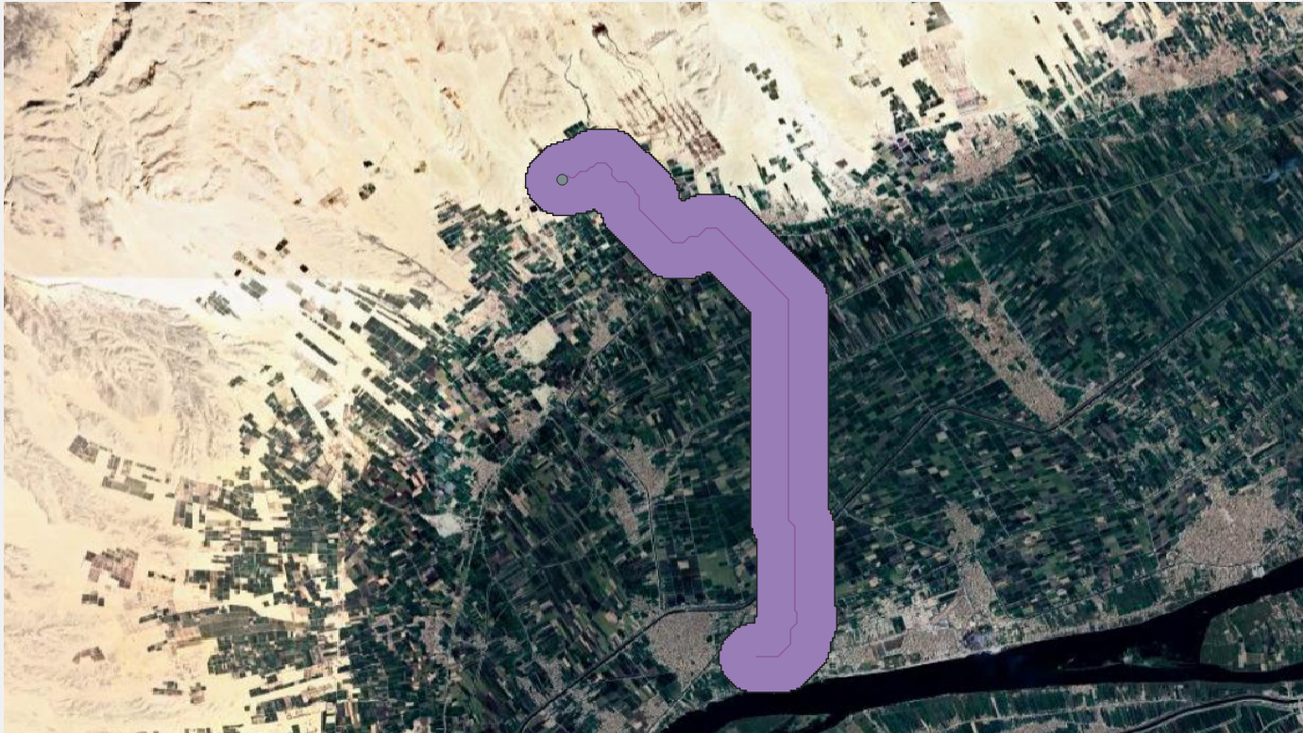
Examples in Egypt
Armant WWTP (11,000 m³/day)
Option 1
Option 2
5km
9 km

Slide 9
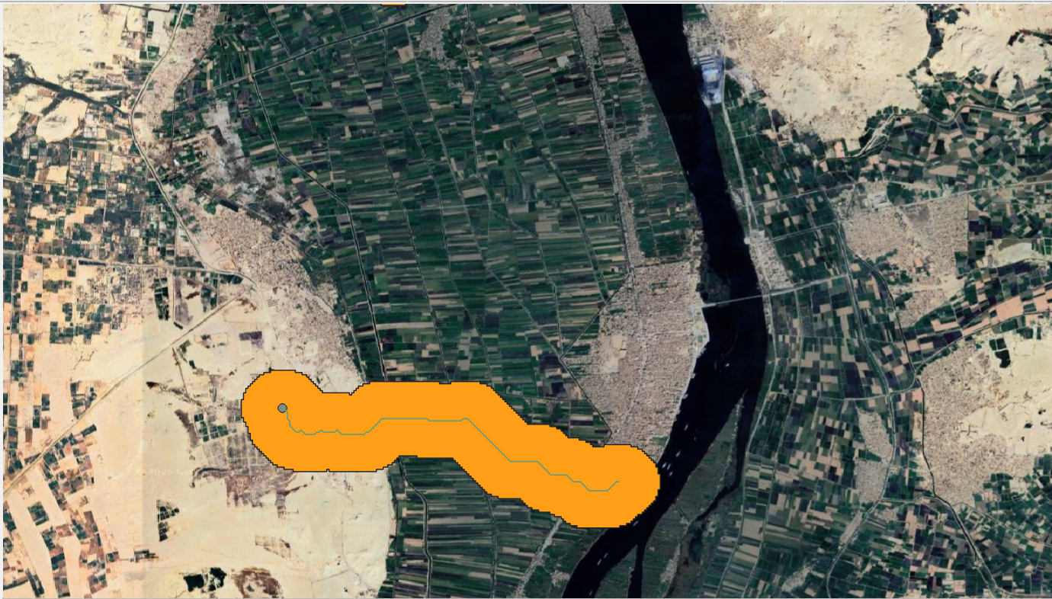
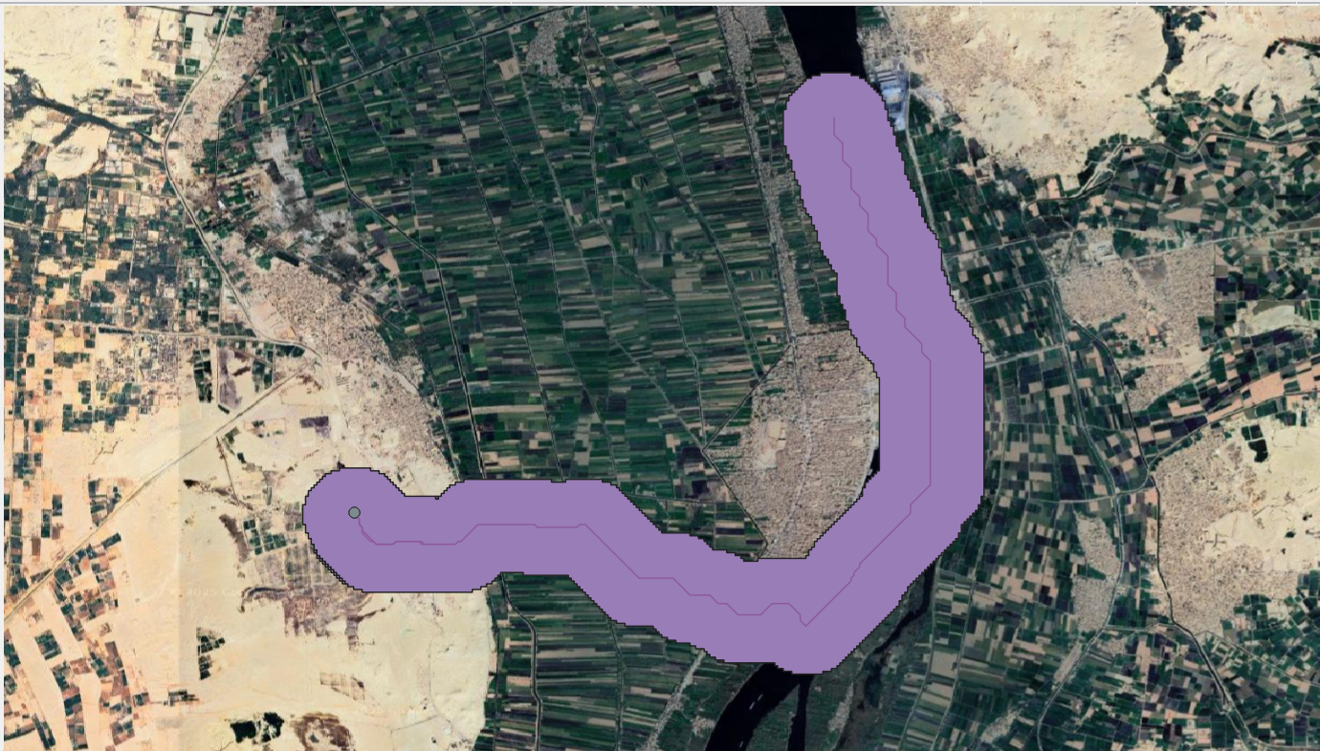
Examples in Egypt
Alhajir WWTP (13,000 m³/day)
Option 1
Option 2
5km
11.5 km

Slide 10
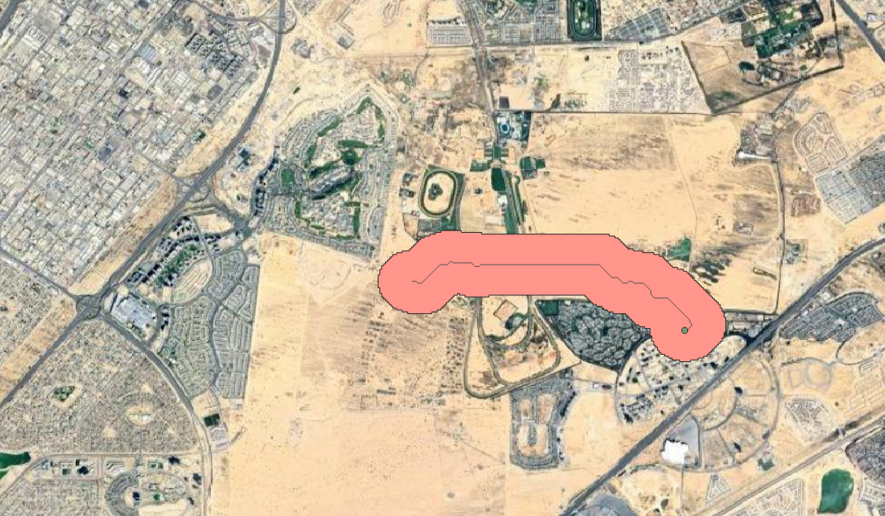
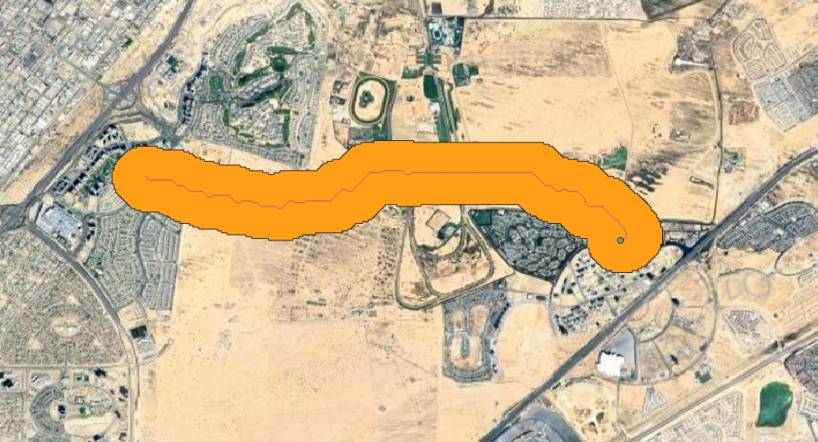
Examples in UAE
Al Barari WWTP (9,300 m³/day)
Option 1
Option 2
5km
8.25 km

Slide 11
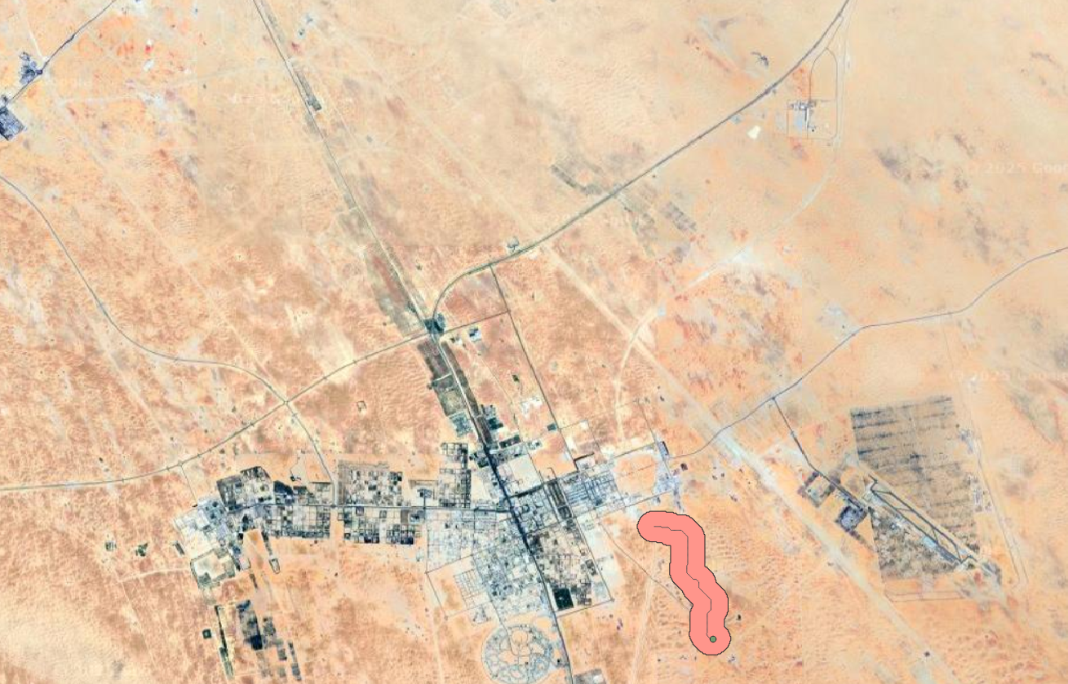
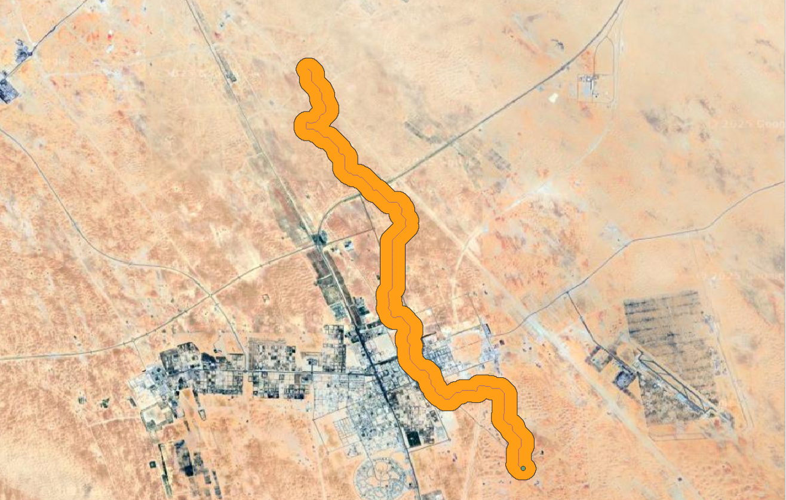
Examples in UAE
Madient zaied WWTP (30,000 m³/day)
Option 1
Option 2
5km
26.5 km

Slide 12
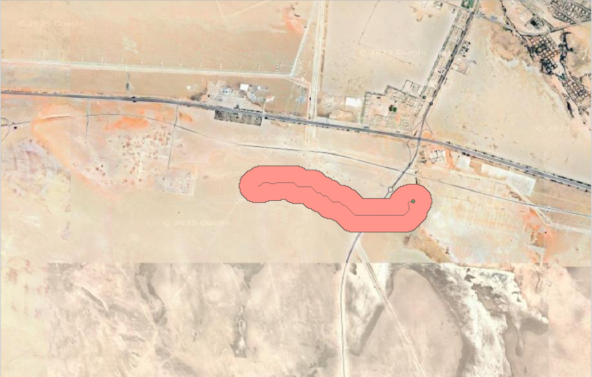
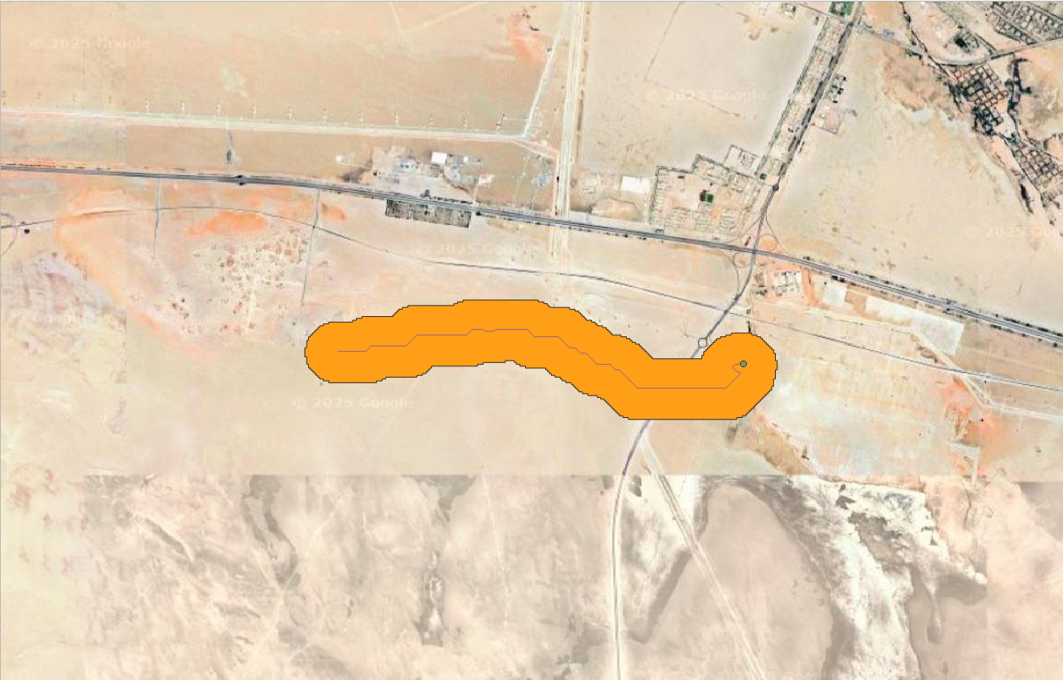
Examples in UAE
Al Mirfaa WWTP (30,000 m³/day)
Option 1
Option 2
5km
7 km

Slide 13
Thank You.

